Slide 1
Assignment 2 Q&A
Xu Wang

Slide 2
image smoothing
Mean Filtering
Gaussian smoothing
Median Filtering

Slide 3
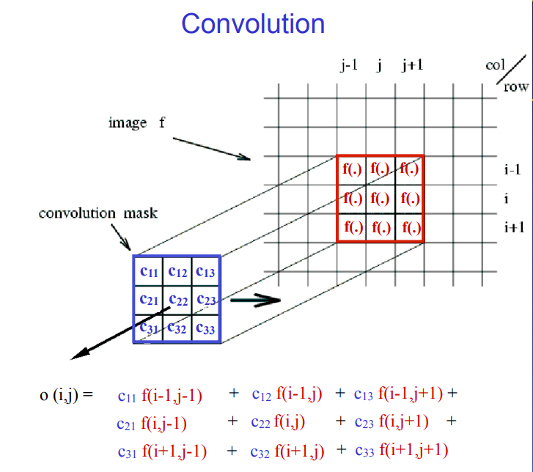
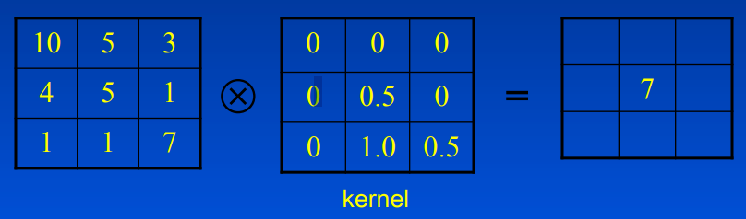

Mean Filtering
Average Filter: $\frac{1}{N^{2}}∗\left(\begin{matrix}1 & ⋯ & 1 \\ ⋮ & ⋱ & ⋮ \\ 1 & ⋯ & 1\end{matrix}\right)$
Convolve the image with the filter

Slide 4

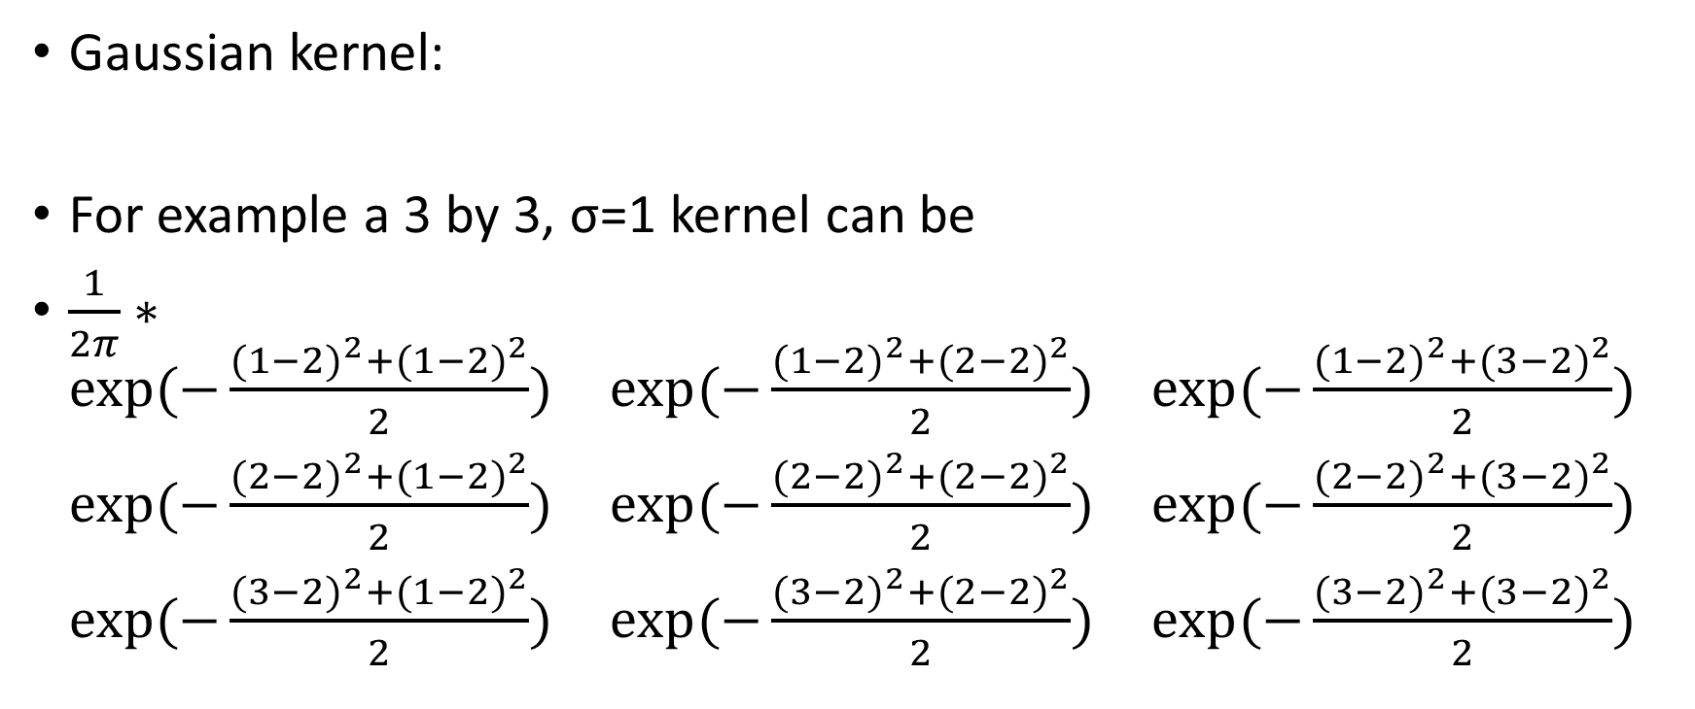
Gaussian Filtering
Gaussian kernel:
For example a 3 by 3, σ=1 kernel can be
$\frac{1}{2π}∗\begin{matrix}exp⁡(−\frac{{(1−2)}^{2}+{(1−2)}^{2}}{2}) & exp⁡(−\frac{{(1−2)}^{2}+{(2−2)}^{2}}{2}) & exp⁡(−\frac{{(1−2)}^{2}+{(3−2)}^{2}}{2}) \\ exp⁡(−\frac{{(2−2)}^{2}+{(1−2)}^{2}}{2}) & exp⁡(−\frac{{(2−2)}^{2}+{(2−2)}^{2}}{2}) & exp⁡(−\frac{{(2−2)}^{2}+{(3−2)}^{2}}{2}) \\ exp⁡(−\frac{{(3−2)}^{2}+{(1−2)}^{2}}{2}) & exp⁡(−\frac{{(3−2)}^{2}+{(2−2)}^{2}}{2}) & exp⁡(−\frac{{(3−2)}^{2}+{(3−2)}^{2}}{2})\end{matrix}$

Slide 5
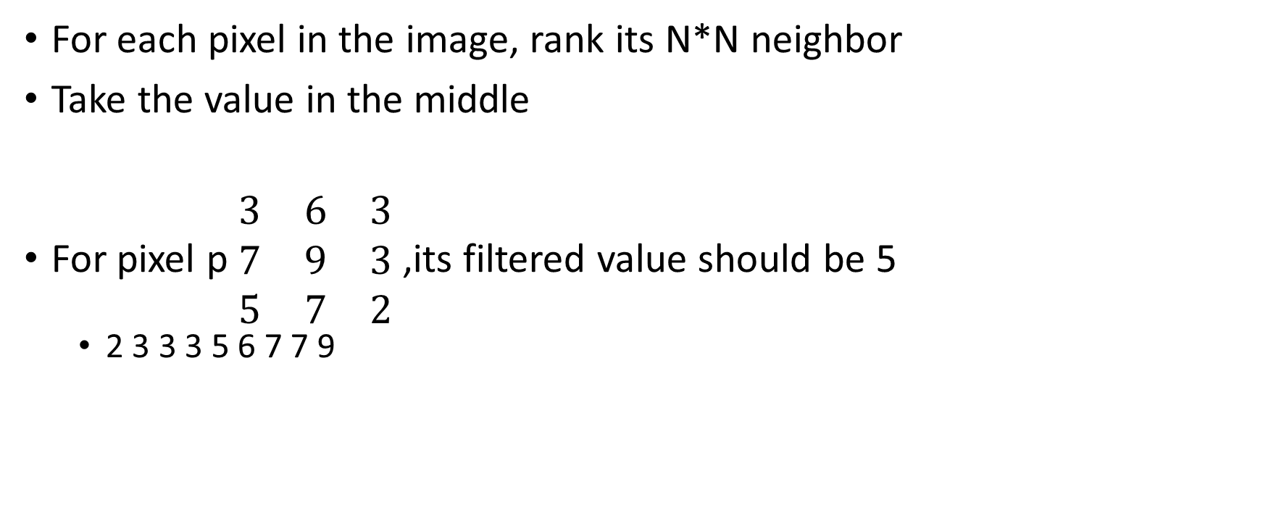
Median Filtering
For each pixel in the image, rank its N*N neighbor
Take the value in the middle
For pixel p $\begin{matrix}3 & 6 & 3 \\ 7 & 9 & 3 \\ 5 & 7 & 2\end{matrix}$ ,its filtered value should be 5
2 3 3 3 5 6 7 7 9

Slide 6
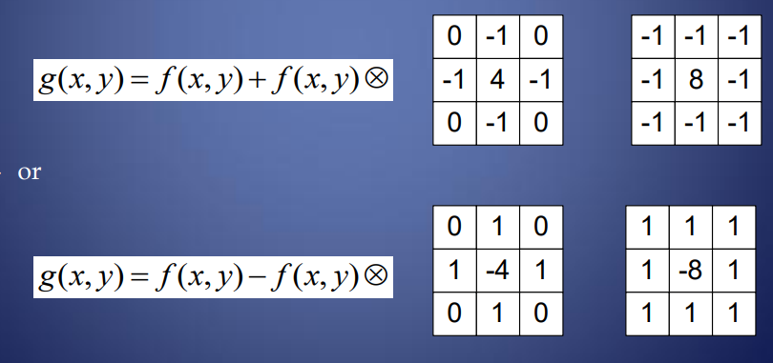
image sharpening

Slide 7
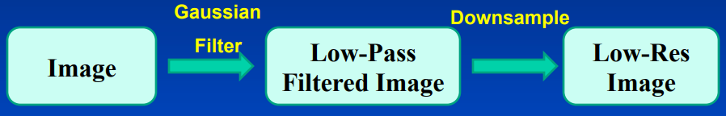
build a Gaussian Pyramid
Gaussian smoothing
Downsample
Downsampled = Image(1:2:h,1:2:w)

